Slide 1
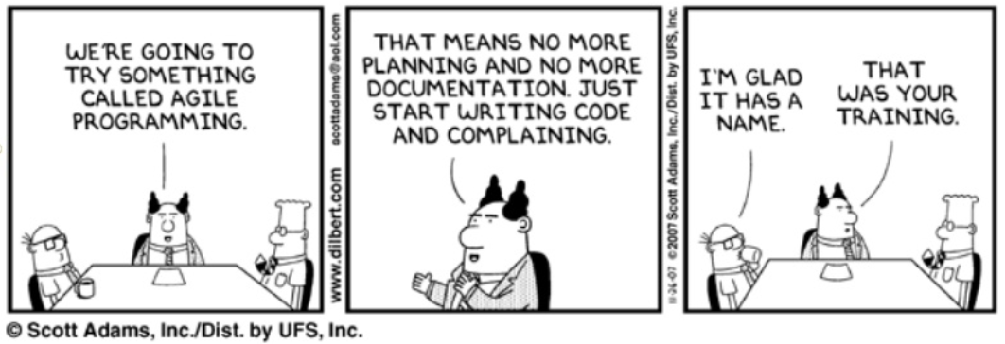
Agile overview

Slide 2
Extreme Programming (XP)
Quick feedback
  Test Driven Development (TDD)
  Customer participation
  Paired programming
Continuous Integration (CI)
  Refactoring
  Frequent small releases
Understanding and Simplicity
  Simplicity of design
  Standards for code writing
  Collective responsibility for code
Social security
  40-hour work week

Slide 3
Scrum
Small multifunctional teams
A well-decomposed list of tasks with priorities (backlog of the product and sprint backlog)
Sprint execution control
Iterations with the final demonstration to the client
Process Retrospective
https://en.wikipedia.org/wiki/Scrum_(software_development)

Slide 4
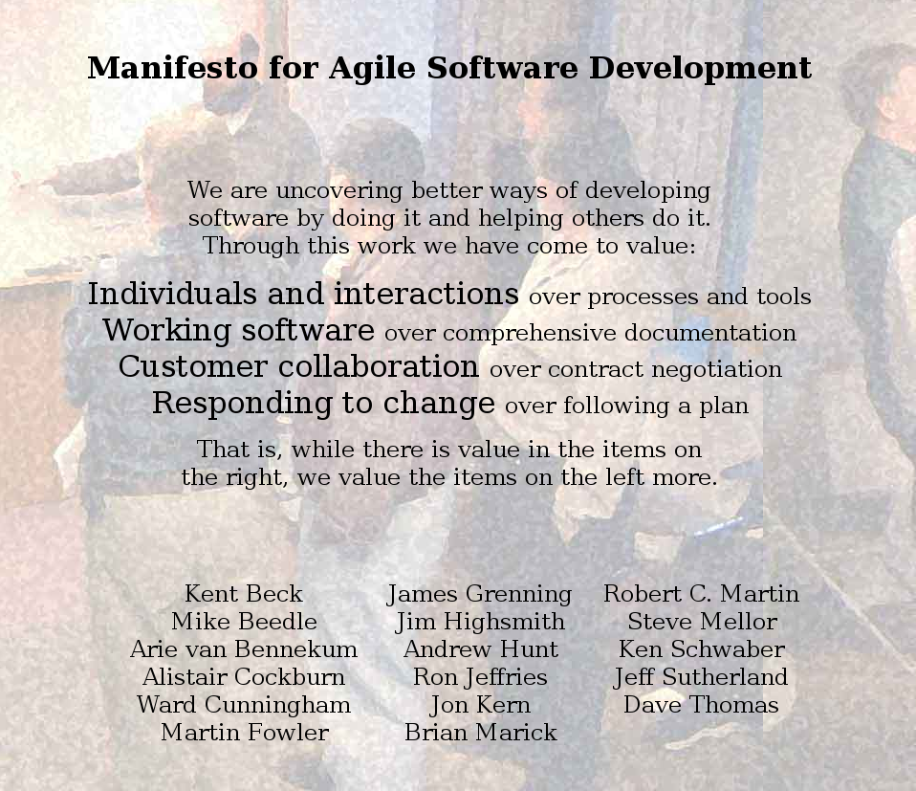



http://agilemanifesto.org/

Slide 5
12 Agile Manifesto Principles
Our highest priority is to satisfy the customer through early and continuous delivery of valuable software.
Welcome changing requirements, even late in development. Agile processes harness change for the customer's competitive advantage.
Deliver working software frequently, from a couple of weeks to a couple of months, with a preference to the shorter timescale.
Business people and developers must work together daily throughout the project.
Build projects around motivated individuals. Give them the environment and support they need, and trust them to get the job done.
The most efficient and effective method of conveying information to and within a development team is face-to-face conversation.
Working software is the primary measure of progress.
Agile processes promote sustainable development. The sponsors, developers, and users should be able to maintain a constant pace indefinitely.
Continuous attention to technical excellence and good design enhances agility.
Simplicity--the art of maximizing the amount of work not done--is essential.
The best architectures, requirements, and designs emerge from self-organizing teams.
At regular intervals, the team reflects on how to become more effective, then tunes and adjusts its behavior accordingly.

Slide 6
Agile principles
Individuals and interactions over processes and tools
Working software over comprehensive documentation
Customer collaboration over contract negotiation
Responding to change over following a plan

Slide 7
1 Put the customer at the center
Beck: You will get better results with real cutomers. They are who you are trying to please

Slide 8
2 Accept change
Poppendieck: While in theory Object Oriented development produces code that easy to change, in practice OO systems can be as difficult to change as any other.
Extendibility!

Slide 9
3 Let the team self-organize
Traditional view: managers tell workers to do their job
Agile view: managers listen to developers, explain possible actions, provide suggestions for improvements
Leader is there to:
Encourage progress
Help catch errors
Remove impediments
Provide support and help in diffucult situations
Make team spirit

Slide 10
4 Maintain sustainable pace
People perform best if they are not overstressed
Develoopers should not work more than 40 hour weeks
To achieve:
Frequent code-merge
Always maintain executable, test-covered, high-quality code
Constant refactoring, helping keep fresh and alert minds
Collaborative style
Constant testing

Slide 11
5 Develop minimal software
Minimalism:
Minimal functionality
Product only
Only code and tests
Jeffries: this principle reminds us always to work on the story we have, not womething we think we're going to need. Even if we know we're going to need it.

Slide 12
5 Develop minimal software
Poppendieck: Our software systems contain far more features than are ever going to be used. Extra features increase the complexity of the code, driving up costs nonlinearly. If even half of our code is unnecessary — a conservative estimate — the cost is not just double; it’s perhaps ten times more expensive than it needs to be.
Cockburn: You get no credit for any item that does not result in running, tested code. Okay, you also get credit for final deliverables such as training materials and delivery documentation.

Slide 13
6 Develop iteratively
User interface
Business logic
Networking
Database
The Closed-Window Rule: During an iteration, no one may add functionality
(or: the sprint is cancelled)

Slide 14
7 Tests
Do not move on until all tests pass
Excellent principle, to be reconciled with practical constraints
Need to classify complexity

Slide 15
8 Express requirements through scenarios
“Stories are more than just text written on an index card but for our purposes here, just think of user story as a bit of text saying something like
Paginate the monthly sales report
Change tax calculations on invoices.
Many teams have learned the benefits of writing user stories in the form of “As a … I … so that …”

Slide 16
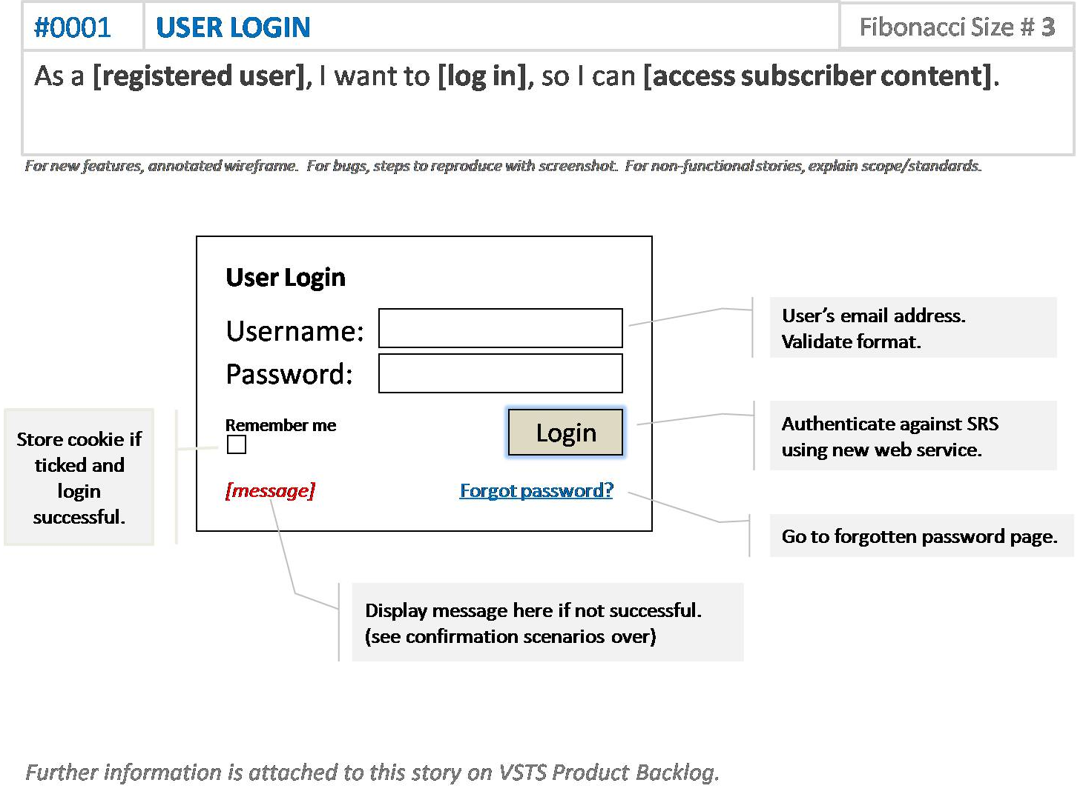
8 User story example

Slide 17
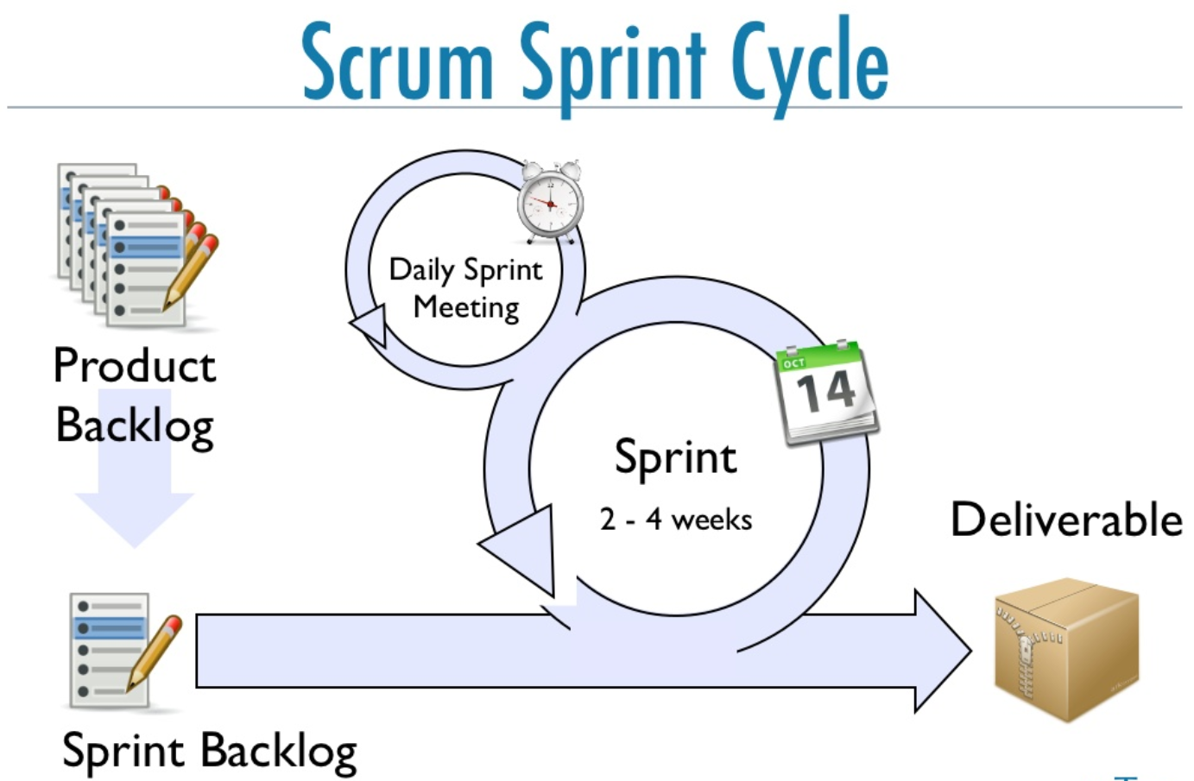

Slide 18
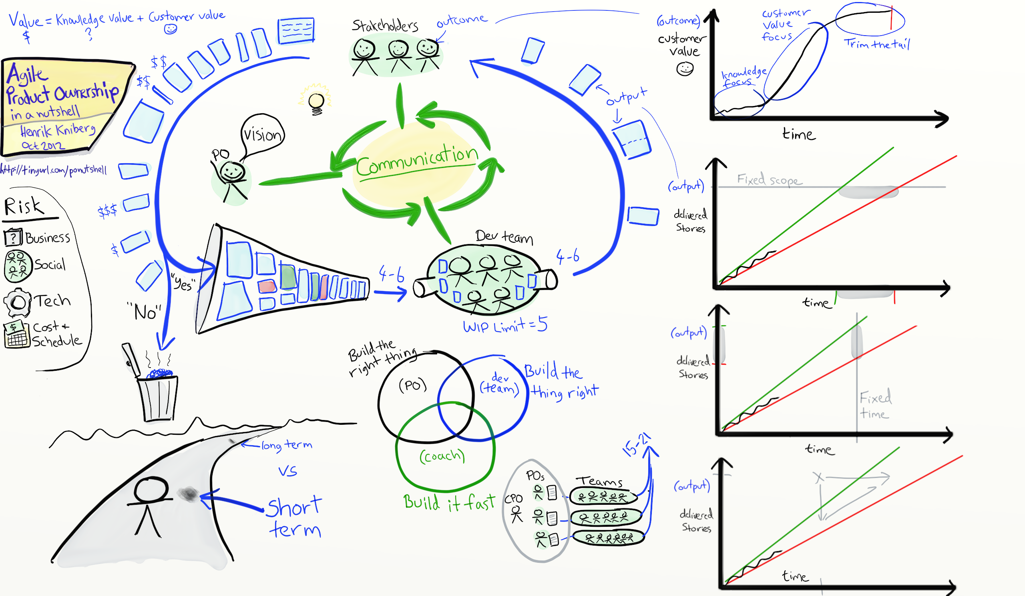
http://blog.crisp.se/2012/10/25/henrikkniberg/agile-product-ownership-in-a-nutshell

Slide 19
Planning and Retrospective meeting
At beginning (Planning) and at the end (Retrospective) of every sprint
Goal: define work for following sprint
Outcome: Sprint Backlog, with time estimate for every task
8-hour time limit
1st half, product owner + team: prioritize product backlog
2nd half, team only: plan for Sprint, producing sprint backlog

Slide 20
Daily meetings
Held every morning
Goal: set the day’s work, in the broader context of the project
Time-limited, usually 15 minutes (“stand-up meeting”)
Involves all team members, with special role for “committed” (over just “involved”)
Focus:
What are you going to do today? Defining commitments
What have you done yesterday?
Do you have difficulties? Uncovering impediments

Slide 21
Scrum roles
Product owner.
Represents the product’s stakeholders and the voice of the customer. Responsible for delivering good business results. PO defines the product in customer-centric terms (user stories), adds them to the Product Backlog and prioritizes them. Scrum team should have only one product owner.
(Self-organizing) development team
Usually 3 to 9 members. Can include researchers, architects, designers, data specialists etc.
Scrum Master
Accountable for removing team difficulties to deliver product goals.
Educating stakeholders on Agile and Scrum, coaching the development team, helping the Product Owner maintain the product backlog.

Slide 22
Team
The team:
Is cross-functional
Has 7+/- 2 members
Selects iteration goal and work results
Organizes itself and its work
Can do everything within guidelines to reach goal
Demos work results to product owner

Slide 23
Product owner
The product owner:
Defines product features
Decides on release date
Decides on release content
Responsible for product profitability (ROI)
Prioritizes features according to market value
Can change features and priority over 30 days
Accepts or rejects work results

Slide 24
Scrum master
The Scrum Master:
Ensures that the team is functional and productive
Enables cooperation across all roles & functions
Shields team from external interferences
Enforces process: daily meeting, planning & review meetings
Removes impediments
Normally, does not develop

Slide 25
«Other» people
Product Marketing
Marketing Communication
Directors
Executives
Can attend dailies but cannot speak. Can participate in planning. Interact with team through Project Manager/ScrumMaster

Slide 26
Product Manager vs Product Owner
Product Owner owns the message to the Agile team and the Sprint/Iteration Backlog
Product Manager owns the Roadmap / Strategy / Vision / Product Backlog
Often they are the same person

Slide 27
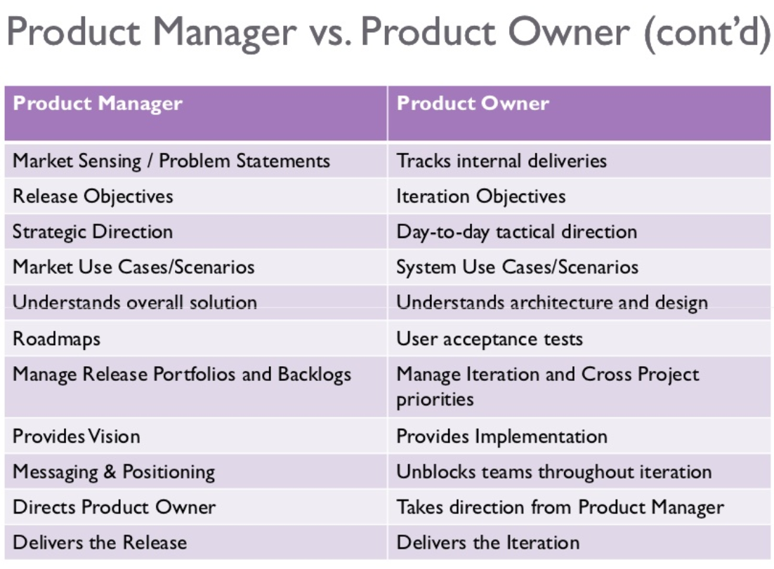

Slide 28
Agile artifacts: use case
Describes how to achieve single business goal or task through the interactions between external actors and system
One of the UML diagram types

Slide 29
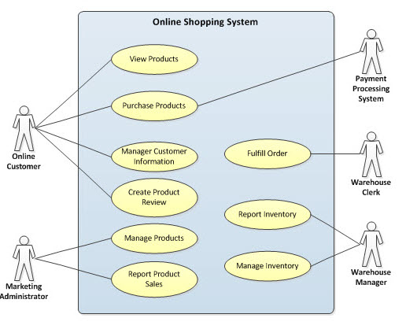
Use case example

Slide 30
Use case vs User story
User story:
Very simple
Written by customer
Incomplete, possibly inaccurate
Does not handle exceptional cases
Starting point for additional discussions with customer
Use case:
More complex
Written by developer in cooperation with customer
Attempts to be complete, accurate
Should handle all possible cases
Intended to answer any developer questions about customer requirements without further interaction with customer

Slide 31
Product backlog
Maintained throughout project
Property of product owner
Open and editable by anyone
Contains backlog items: broad descriptions of all potential features, prioritized by business value
Includes estimates of business value
Includes estimates of development effort, set by team
Visualized in “task board” (see next)

Slide 32
Backlog
Backlog is the master list of all functionality
Features
Epics
Stories
Requirements
Bugs
Item Attributes:
Desctription
Cost estimate (points or size)
Priority

Slide 33
Product Backlogs vs Sprint Backlogs
Product Backlog is the master of all functionality for the product
Features
Epic
Bugs
Sprint Backlog is the list of functionality that the team is commiting that they will complete in the current iteration
Stories
Requirements
Bugs

Slide 34
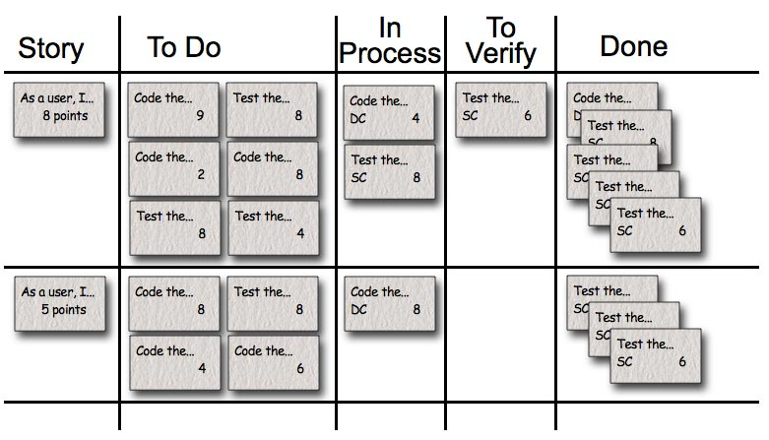
Task board, story board
Used to see and change the state of the tasks of the current sprint: “to do”, “in progress”, “done”.
Benefits:
Transparency
Collaboration
Prioritization
Focus
Self-organization
Empiricism
“Humility”
Morale

Slide 35
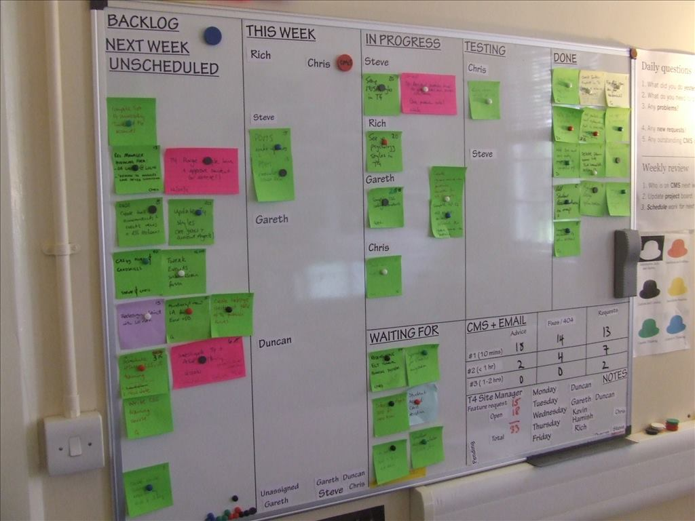
Task board, story board

Slide 36
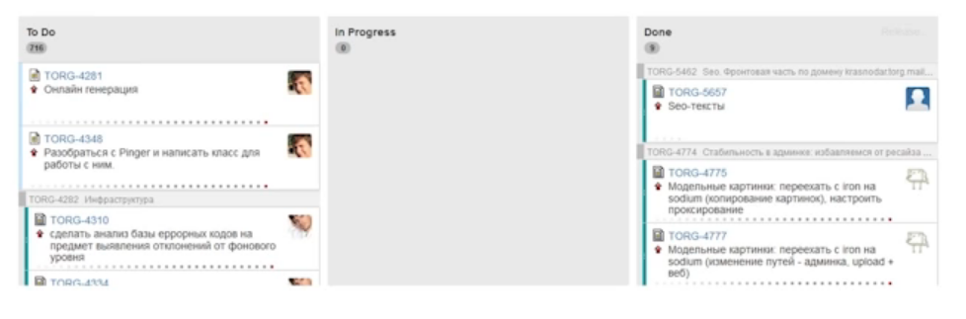
Task board in Jira

Slide 37
Agile ugly
Rejection of upfront tasks
  Particularly: no upfront requirements
  Dismissal of a priori architecture work
User stories as a replacement for abstract requirements
Tests as a replacement for specifications
Feature-based development & ignorance of dependencies
Method keeper (e.g. Scrum Master) as a separate role
Test-driven development (but not the rest of agile’s emphasis on tests)
Dismissal of traditional manager tasks
Dismissal of auxiliary products and non-shippable artifacts
Dismissal of a priori concern for extendibility
Dismissal of a priori concern for reusability

Slide 38
Agile good
Acceptance of change
Iterative development
Emphasis on working code
Tests as one of the key resources of the project
Constant test regression analysis
Notion of velocity
No branching
Product (but not user stories!) burndown chart
Daily meeting

